Slide 1

𝓗𝓘𝓜𝓞𝓥𝓐𝓣𝓘𝓞𝓝 2026: 𝕊𝕠𝕝𝕧𝕖-𝕒-𝕋𝕙𝕠𝕟
Problem Statement Title- An AI-Powered Operating System for Smarter, Safer & Responsive Cities
Theme- AI for Smart Cities
Team Name (As per the Registered Form)- Cortisol Override
Name of Team Member with Affiliation-
Prajwal Kumar Bakaningi
Prem Dandin
Someshwar kumbar
Mohammed Tayyab Nalband
Zaid Hassan P Konnur

Slide 2
PROBLEM STATEMENT (Describe your Problem Statement )
A CITY PROBLEM IS RARELY JUST ONE PROBLEM:
  Cities generate enormous amounts of information from citizens, CCTV, sensors, GIS, traffic systems and government departments. Yet this information often remains fragmented.
The Challenges:
Citizens are forced to follow up
People report problems but often don't know who is responsible or when the issue will be resolved.
Departments work in silos
Water, waste, traffic, police, healthcare and disaster teams often operate with separate information and workflows.
Cities remain reactive
Most action begins after a flood, pothole, waste overflow, infrastructure failure or congestion becomes critical.
Connected incidents are treated separately
Single flood can cause road closures, traffic congestion, ambulance delays and hospital accessibility problems.
Data does not automatically become decisions
Cities have data, but lack a unified intelligence layer to transform it into coordinated action.
AI needs to be trusted
A prediction is not enough. Decision-makers need to know why the system recommends an action.
THE REAL GAP:
Cities can detect events — but struggle to understand how they are connected, what happens next, and what action matters
most.
Example:
Flood → Road Closure → Traffic → Ambulance Delay → Hospital Risk
“The problem is not lack of data. It is lack of connected intelligence.”

Slide 3
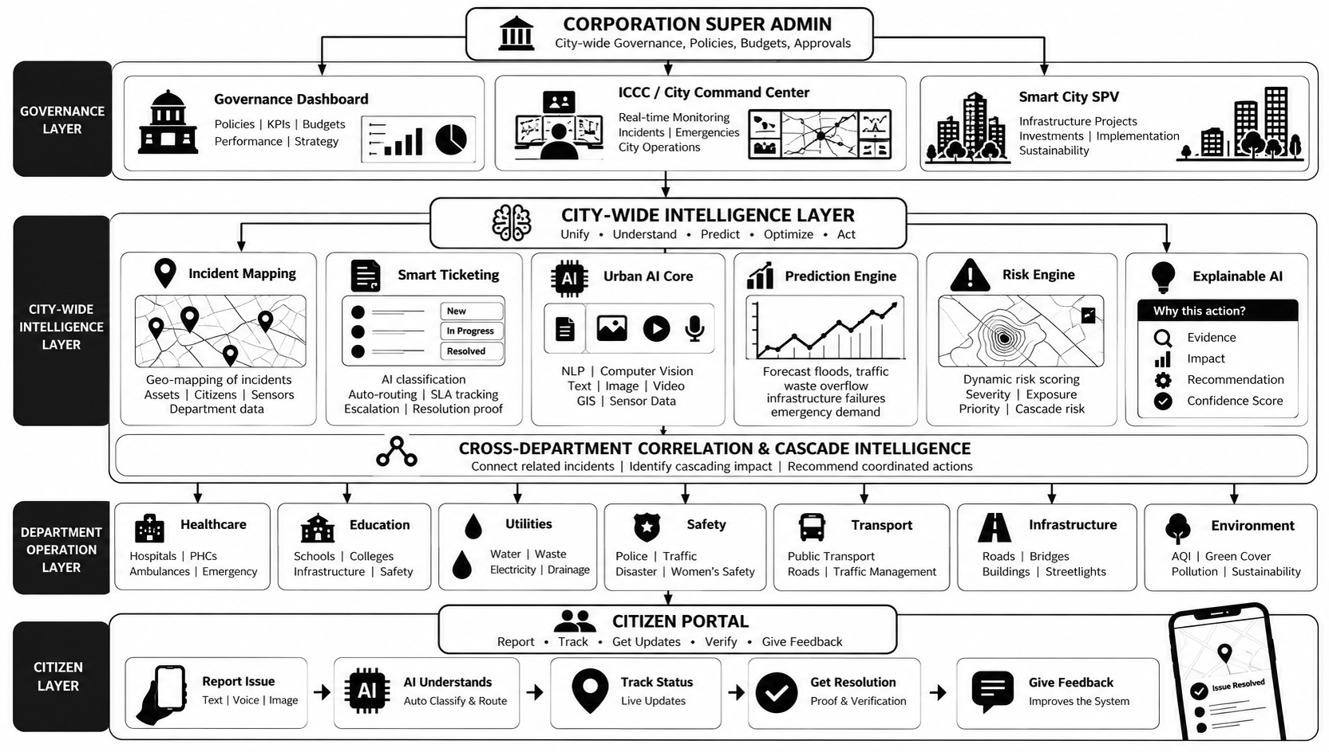
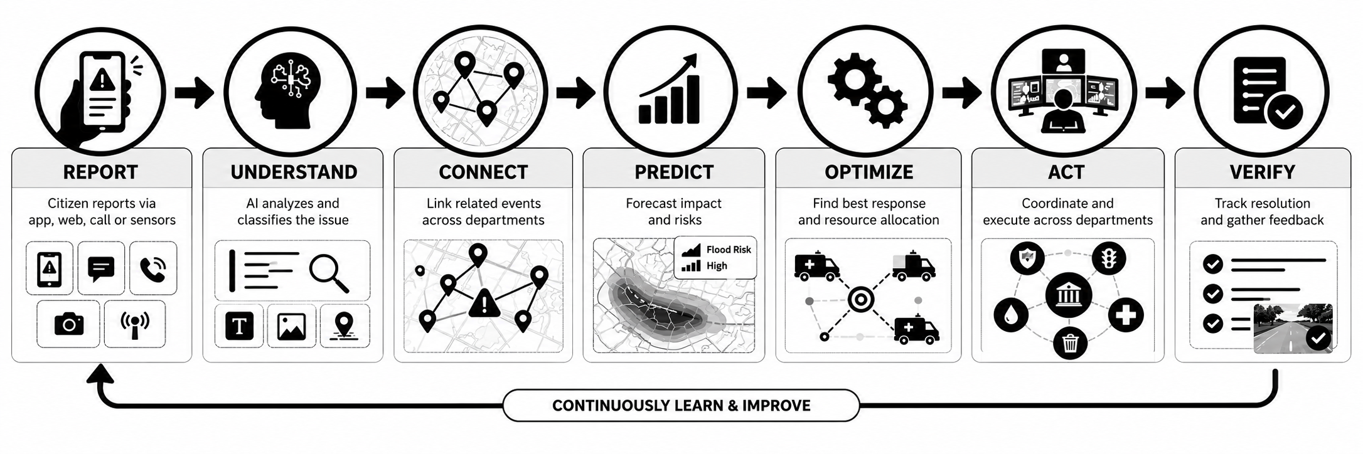
PROPOSED SOLUTION (Describe your Idea/Solution/Prototype)
URBAN INTELLIGENCE — AI-POWERED CITY OPERATING SYSTEM
Detailed explanation of the proposed solution:
Unified AI Layer -
Connects citizens, departments, sensors and city systems.
Smart Intelligence -
AI detects, classifies, maps and predicts urban problems.
Connected Response -
Smart tickets and cross-department correlation coordinate action.
Decision Intelligence -
Digital Twin, quantum optimization and Explainable AI support better decisions
How it addresses the problem:
.
Innovation and uniqueness of the solution
Cross-department intelligence
Predictive & preventive action
AI + Quantum Optimization
Digital Twin what-if simulation
Explainable, human-approved decisions

Slide 4
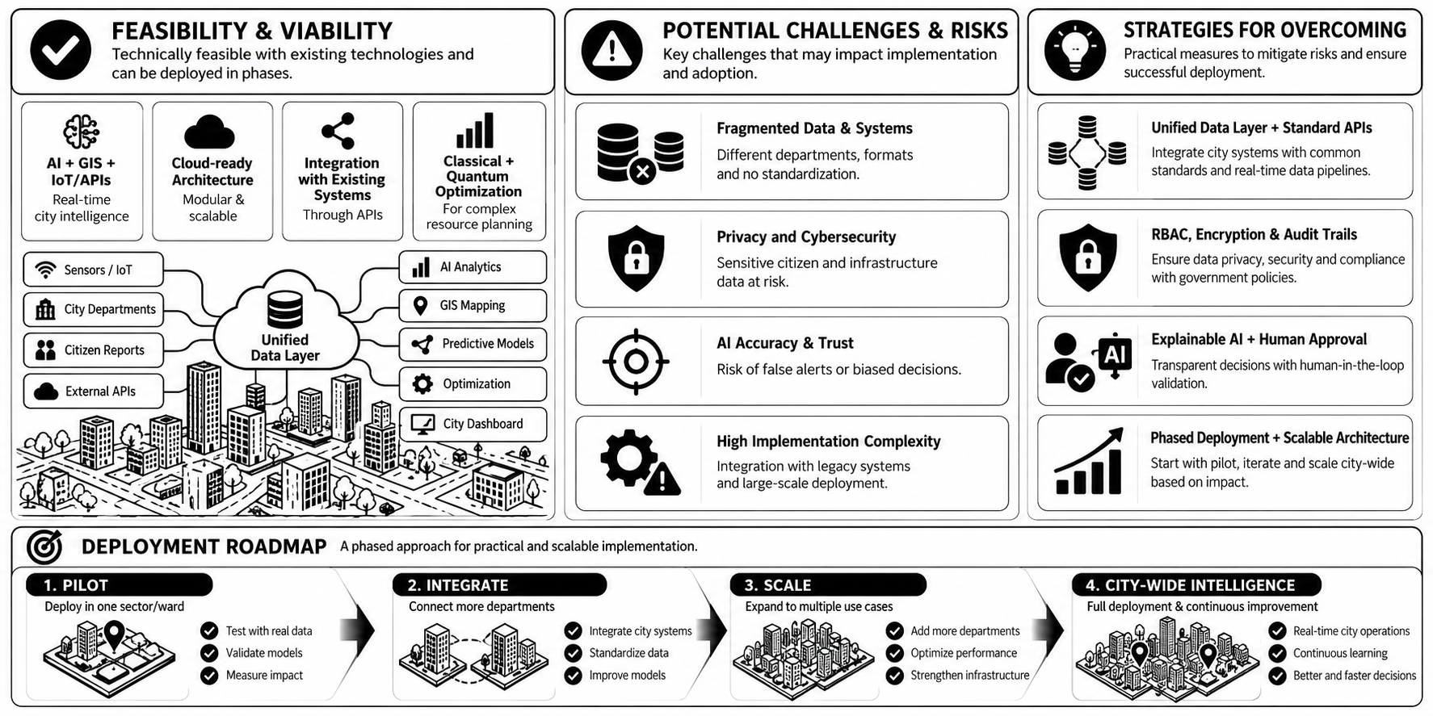
FEASIBILITY AND VIABILITY
Analysis of the feasibility of the idea:
Technically feasible with AI, GIS, IoT, APIs and cloud technologies.
Scalable through modular, phased deployment.
Integrable with existing city systems using standard APIs.
Strategies for overcoming these challenges
Potential challenges and risks
Fragmented data & systems
Privacy and cybersecurity
AI accuracy & trust
High implementation complexity
Explainable AI + human approval
Unified data layer + standard APIs
RBAC, encryption & audit trails
Phased deployment + scalable architecture

Slide 5
Research Prototype & Resources
Research Foundation:
Digital Twins for Smart Cities — IEEE Research Paper
Explainable AI for Smart Cities — MDPI Research Paper
GenAI + Digital Twins in Smart Cities — IEEE 2025 Research Paper
Quantum Optimization for Vehicle Routing (QAOA) — Research Paper
Documentation:
GitHub Repository : https://github.com/qsum99/Smart-city.git
Demo Video & Documentation : https://drive.google.com/drive/u/1/folders/130hEzUrw4-m4KWHOEPPKOOb0veuqNAXJ

